Slide 1
Criminology Annual Survey: Student Perceptions of Law Enforcement & Victimization: Regression Models and Statistical Analysis
Melea Mendrin

Slide 2
Question 1
Exploring potential correlation between Appendix F: Just-World and Sexism Scales to Appendix D: Attitudes toward Police Legitimacy Scale (APLS)
Recall:
Appendix D: Attitudes toward Police (APLS) has 34 questions in which survey takers choose a response from 1 to 6.
Appendix F can be broken down into 5 sections (each a survey question):
Global Belief in a Just World Scale (GBJW 1-7)
Hostile Sexism Towards Women (ASI 1-6)
Benevolent Sexism Towards Women (ASI 7-12)
Hostile Sexism Towards Men (AMI 1-6)
Benevolent Sexism Towards Men (AMI 7-12)
Do any of these factors from Appendix F have correlation with attitudes towards police (APLS)?

Slide 3
Question 1
Which section of Appendix F has the greatest correlation on attitudes towards police APLS?
Create simple linear regression models using the mean values for each section of Appendix F so that a general idea of the correlations can be found
Using the Variable Codebook
Titles of mean columns for each predictor (We will use these for the upcoming models)
Attitude Towards Police (APLS columns 1-34)
Global Belief in a Just World Scale (GBJW columns 1-7)
Hostile Sexism Towards Women (ASI columns 1-6)
Benevolent Sexism Towards Women (ASI columns 7-12)
Hostile Sexism Towards Men (AMI columns 1-6)
Benevolent Sexism Towards Men (AMI columns 7-12)
APLS
GBJW
ASI_HostileSexism
ASI_BenevolentSexism
ATM_HostileSexism
ATM_Benevolent Sexism

Slide 4
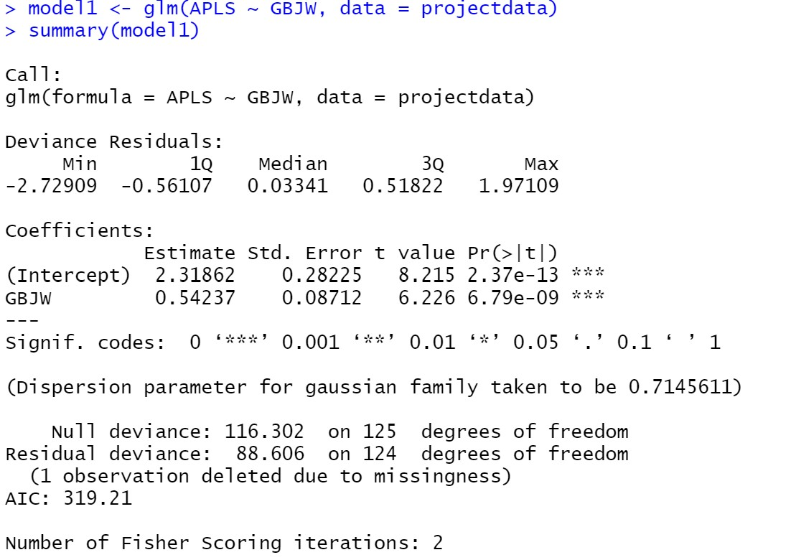
Model 1
Attitude Towards Police (APLS) as response (Y) and World Views (GBJW) as predictor (X)
Generalized linear model comparing worldviews (GBJW) as predictor to attitudes towards police (APLS) as response.
Regression coefficient: 0.54
P-value: 6.79e-09 (significant)
There appears to be a positive correlation between world view and attitude towards police.
For each 1 unit increase in worldview, there is a 0.54 increase in attitude towards police.
Recall: attitude towards police is measured on a 1-6 scale with 6 being positive attitude

Slide 5
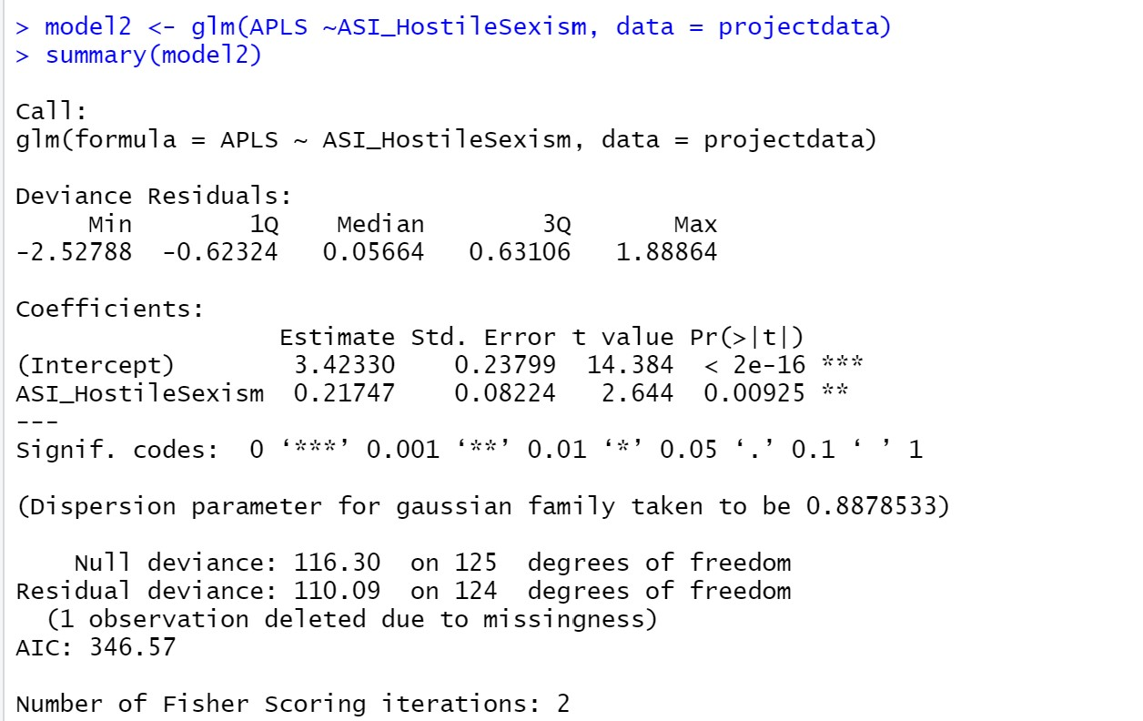
Model 2
Attitude Towards Police (APLS) as response (Y) and Hostile Sexism Towards Women (ASI_HostileSexism) as predictor (X)
Comparing hostile sexism Women (ASI_HostileSexism) to attitude towards police (APLS).
Regression coefficient: 0.22
P-value: 0.00925 (significant)
There appears to be a positive correlation between hostile sexism towards women and attitude towards police.

Slide 6
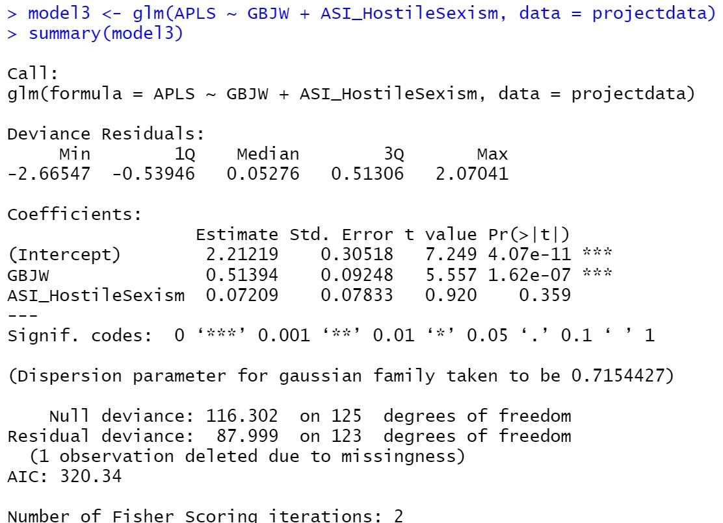
Model 3
Attitude Towards Police (APLS) as response (Y) and Hostile Sexism Towards Women (ASI_HostileSexism) and World Views (GBJW) as predictors (X)
Comparing hostile sexism Women (ASI 1-6) and worldviews (GBJW) simultaneously to attitude towards police (APLS).
Regression coefficient (worldview) : 0.52
P-value(worldview) : 1.62e-07 (significant)
Regression coefficient (hostile sexism Women) : 0.072
P-value(hostile sexism Women) : 0.359 (NOT significant)
When hostile sexism (Women) and world views are taken into account simultaneously, it is found that hostile sexism towards women has no significant effect on attitudes towards police after all. Meanwhile, world view continues to remain significant.

Slide 7
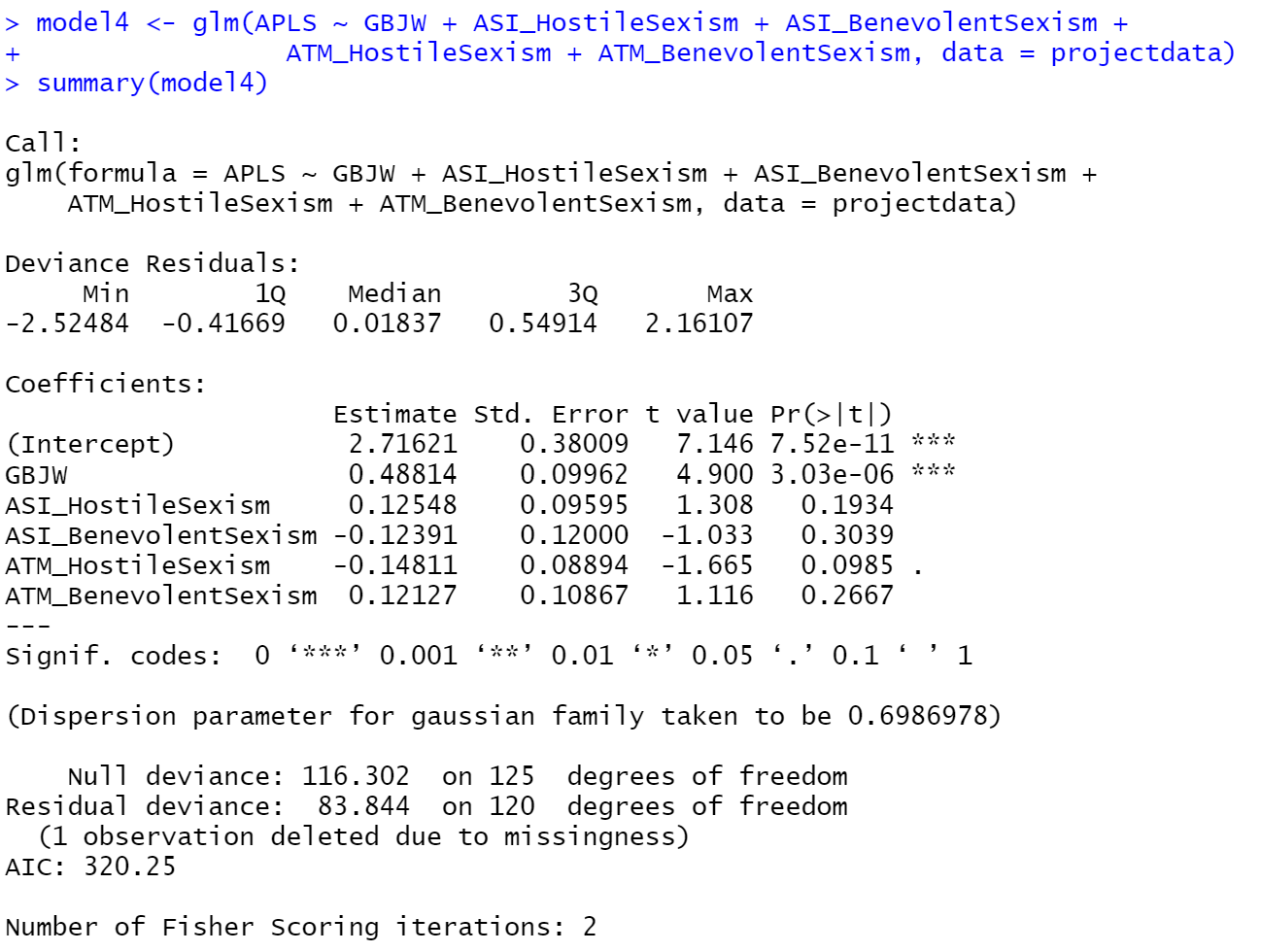
Model 4
Attitude Towards Police (APLS) as response (Y) and all sections of appendix F as predictors (X)
Comparing all sections of appendix F ( World Views, Hostile Sexism toward Women, Benevolent Sexism toward Women, Hostile Sexism toward Men, and Benevolent Sexism toward Men simultaneously to attitude towards police (APLS).
Regression coefficient (worldview) : 0.49
P-value(worldview) : 3.03e-06 (significant)
Regression coefficient (hostile sexism Women) : 0.13
P-value(hostile sexism Women) : 0.19 (NOT significant)
Regression coefficient (benevolent sexism Women) : -0.12
P-value(benevolent sexism Women) : 0.3 (NOT significant)
Regression coefficient (hostile sexism Men) : -0.15
P-value(hostile sexism Men) : 0.098 (NOT significant)
Regression coefficient (benevolent sexism Men) : 0.12
P-value(benevolent sexism Men) : 0.27 (NOT significant)

Slide 8
Results From Models 1-4
Model | Predictors of Attitudes Towards Police (APLS) | AIC Value
Model 1 | World Views (GBJW) | 319.21
Model 2 | Hostile Sexism Towards Women (ASI_HostileSexism) | 346.57
Model 3 | Hostile Sexism Towards Women (ASI_HostileSexism) and World Views (GBJW) | 320.34
Model 4 | All sections of appendix F (World Views, Hostile Sexism toward Women, Benevolent Sexism toward Women, Hostile Sexism toward Men, and Benevolent Sexism toward Men) | 320.25
When all sections of Appendix F ( World Views, Hostile Sexism toward Women, Benevolent Sexism toward Women, Hostile Sexism toward Men, and Benevolent Sexism toward Men) are taken into consideration all together, it is found that the only significant predictor of attitude toward police (Appendix D) is world views. Since Model 1 has the lowest AIC value, we consider this model to be the best fit. For each 1 unit increase in worldview, there is a 0.49 increase in attitude towards police.
Since World Views (GBJW) appears to be the only significant correlation with Attitude Towards Police (APLS), we choose Model 1 as the best response for determining which section of Appendix F has the greatest correlation on attitudes towards police APLS.

Slide 9
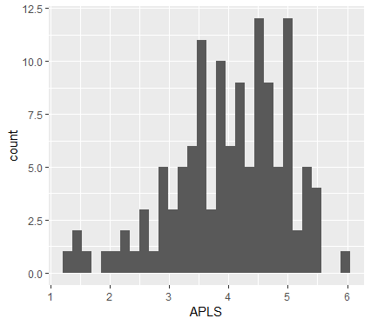
Model 1
Attitude Towards Police (APLS) as response (Y) and World Views (GBJW) as predictor (X)
Histogram of survey responses Attitude Towards Police. On a scale of 1-6, majority of survey respondents chose between 3-5. It appears most respondents have a more positive attitude towards police.

Slide 10
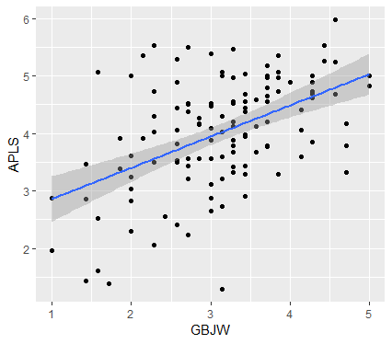
Model 1
Attitude Towards Police (APLS) as response (Y) and World Views (GBJW) as predictor (X)
Significant relationship between GBJW and APLS

Slide 11
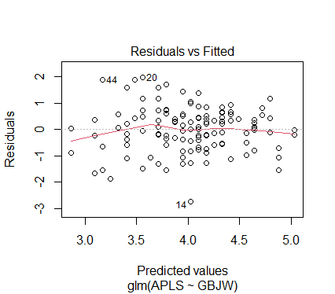
Model 1
Attitude Towards Police (APLS) as response (Y) and World Views (GBJW) as predictor (X)

Slide 12
Question 2
Based on survey responses to question 13 in Appendix J:
Do you intend to pursue a career related to criminal justice?
No (0)
Yes (1)
I am currently employed in a criminal justice field (2)
Prefer not to answer (9)
Using logistic regression models to explore potential correlation between interest in criminal justice careers (CJCareerInterest) as response (Y) and GBJW, APLS, ASI_HostileSexism, ASI_BenevolentSexism, ASI_HostileSexism, ATM_HostileSexism, ATM_BenevolentSexism as predictors (X)
Do any of these factors have a correlation with whether a person wants to pursue a criminal justice career (CJCareerInterest)?
Global Belief in a Just World Scale (GBJW 1-7)
Hostile Sexism Towards Women (ASI 1-6)
Benevolent Sexism Towards Women (ASI 7-12)
Hostile Sexism Towards Men (AMI 1-6)
Benevolent Sexism Towards Men (AMI 7-12)
Attitudes toward Police Legitimacy Scale (APLS)

Slide 13
Models
Model # | Response variable ~ Predictor variable | Significance
Model 5 | CJCareerInterest ~ APLS | APLS not significant predictor alone
Model 6 | CJCareerInterest ~ GBJW | GBJW not significant predictor alone
Model 7 | CJCareerInterest ~ APLS + ATM_BenevolentSexism | APLS and ATM_BenevolentsSexism are significant predictors together
Model 8 | CJCareerInterest ~ ATM_BenevolentSexism | ATM_BenevolentSexism not significant predictor alone
Model 9 | CJCareerInterest ~ GBJW + APLS + ASI_HostileSexism + ASI_BenevolentSexism + ASI_HostileSexism + ATM_HostileSexism + ATM_BenevolentSexism | Only ATM_BenevolentSexism is significant when taking all potential predictors into account

Slide 14
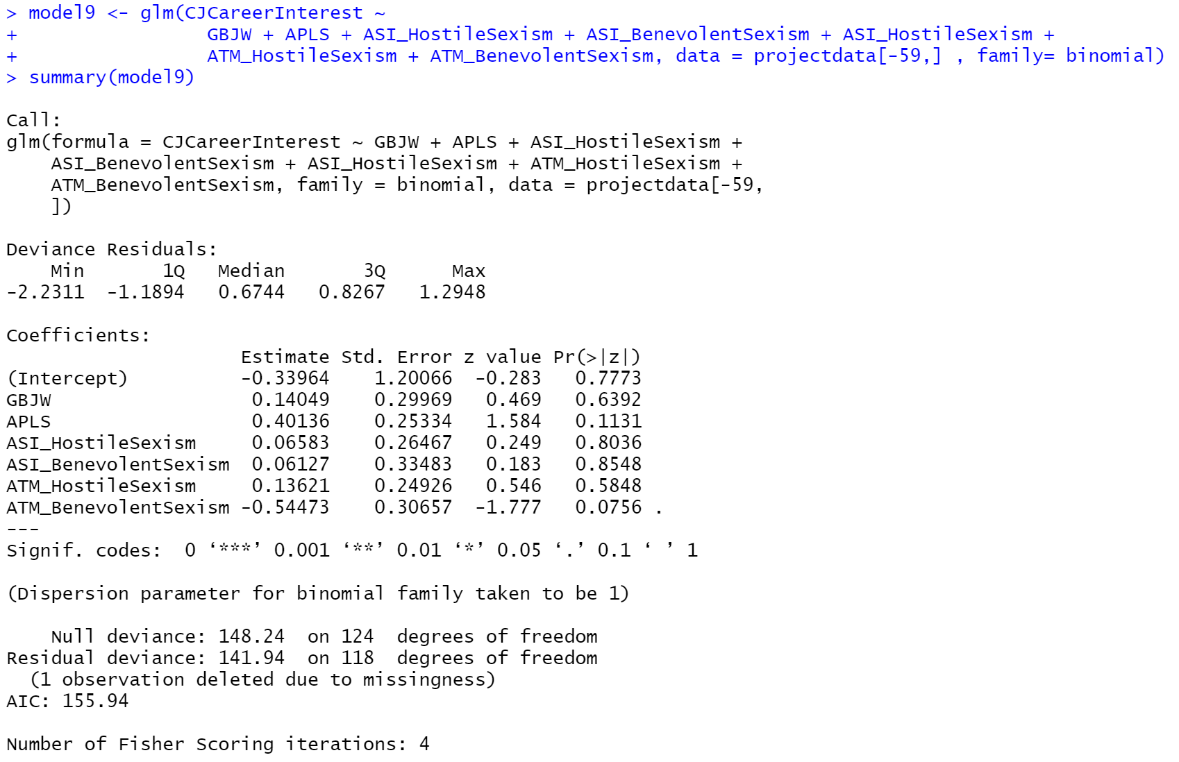
Model 9
Attitude Towards Police (APLS) as response (Y) and World Views (GBJW) as predictor (X)
ATM_BenevolentSexism (benevolent sexism towards men) is significant has p-value (0.0756) when taking each potential predictor into account

Slide 15
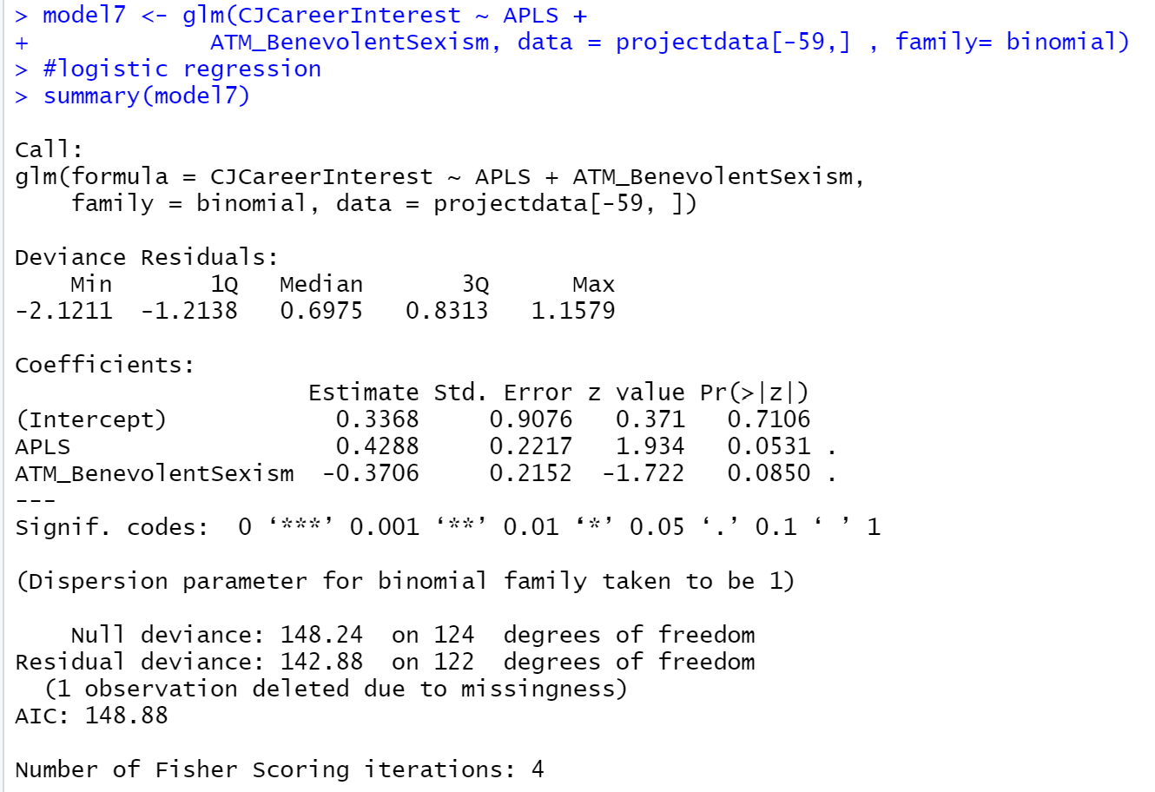
Model 7
Career Interest as response (Y) and attitudes towards police (APLS) and benevolent sexism towards men (ATM_BenevolentSexism) as predictors (X)
When taking both APLS into account, ATM_BenevolentSexism
has a negative relationship at the 0.1 significance level.
When taking ATM_BenevolentSexism into account, APLS has a positive relationship at the 0.1 significance level.
Possible Simpson’s paradox correlation

Slide 16
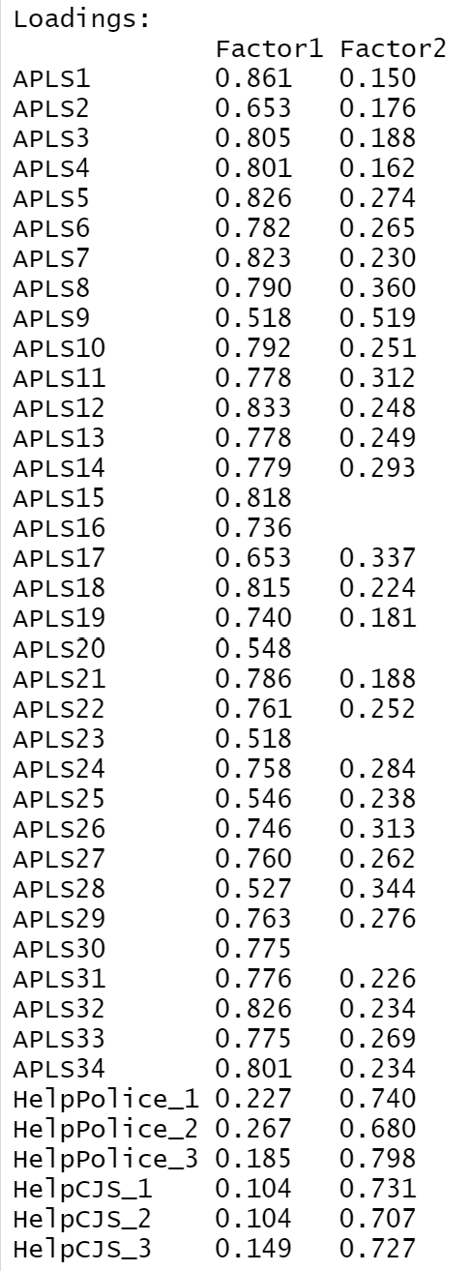
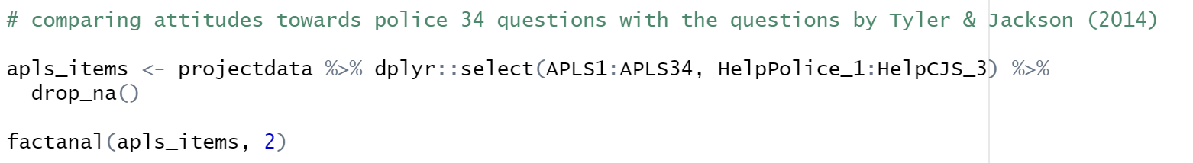
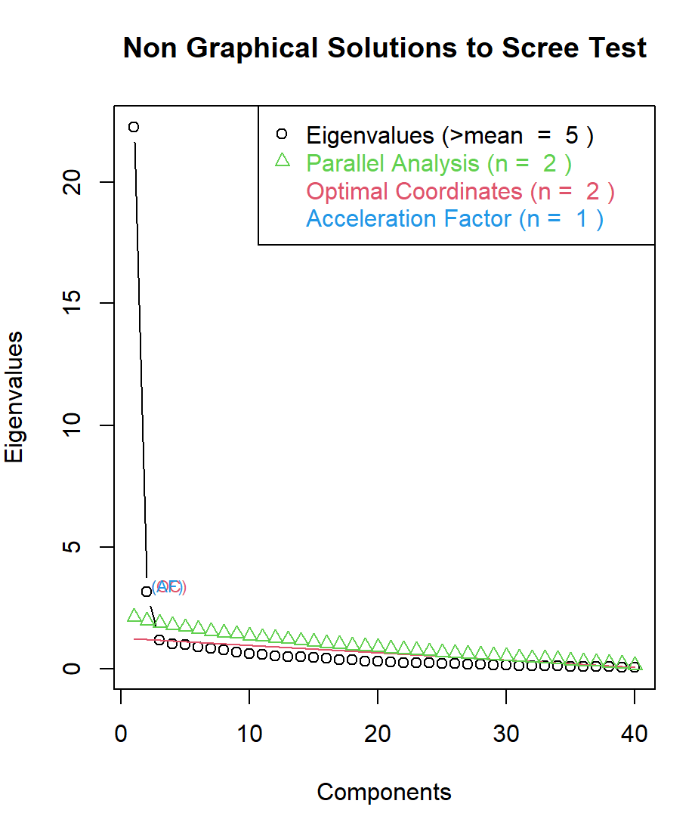
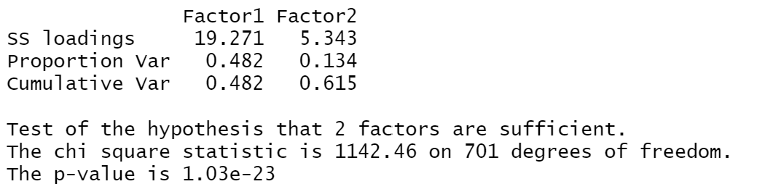
Factor Analysis Model 1
Attitudes Towards Police (APLS), Helping Police (HelpPolice), Helping Legal System (HelpCJS)
Explore whether the survey questions for attitude towards police (APLS) are a part of the same factor as the questions in Helping Police (HelpPolice) and Helping Legal System (HelpCJS) derived from Tyler & Jackson (2014).
Comparing attitudes toward police questions (APLS) with the questions from Tyler & Jackson (HelpPolice & HelpCJS), we see these fit into 2 distinct factors.

Slide 17
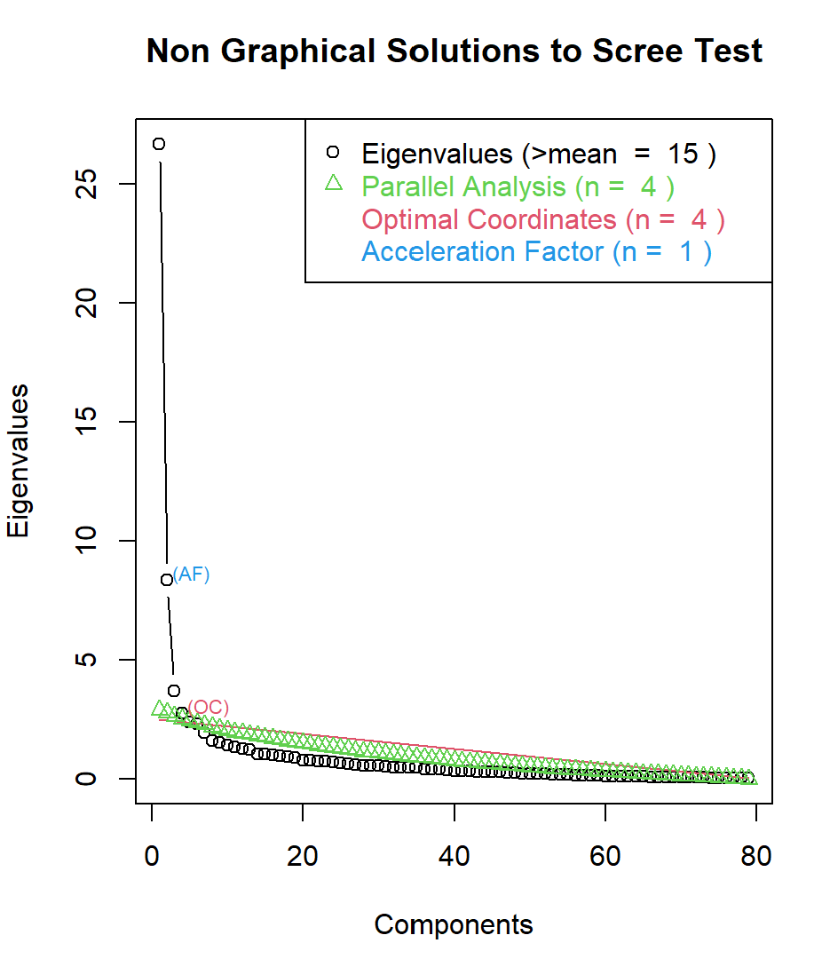
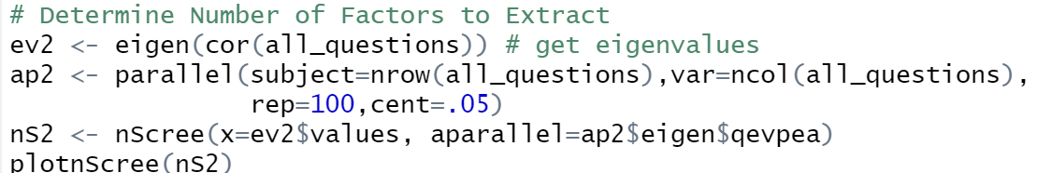
Factor Analysis Model 2
(Scree Plot)
Attitudes Towards Police (APLS), Helping Police (HelpPolice), Helping Legal System (HelpCJS), Effectiveness of Police & Legal System [Accuracy] (Acc), Sexism Women (ASI), Sexism Men (AMI), World Views (GBJW), Effectiveness of Police & Legal System [Effectiveness] (Eff)
Appendices D,E,F
Scree plot indicates 4 factors is ideal

Slide 18
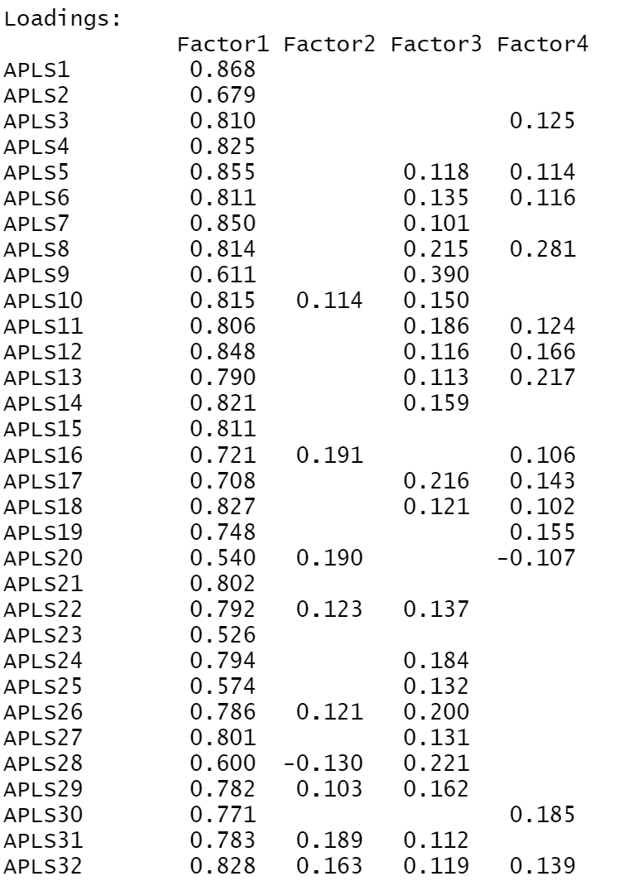
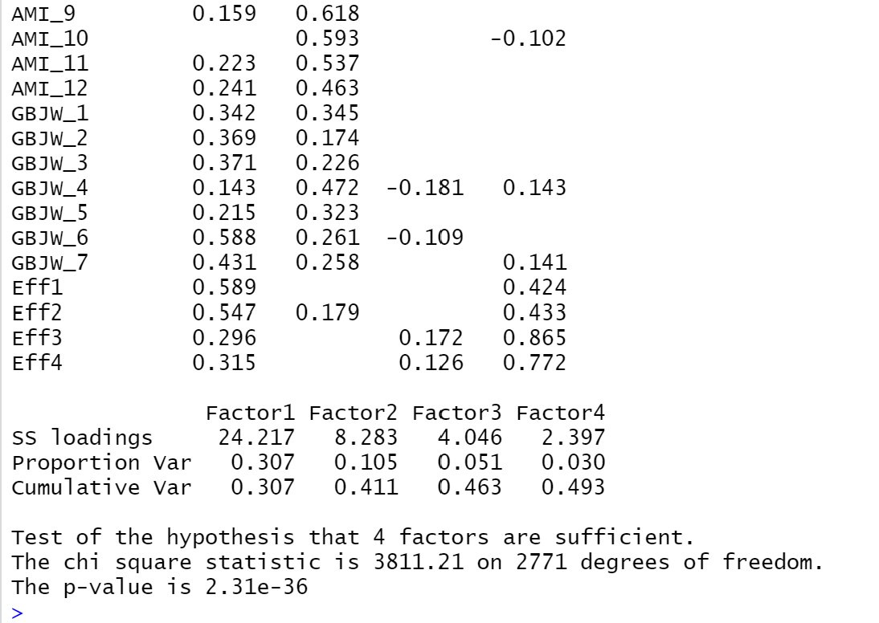
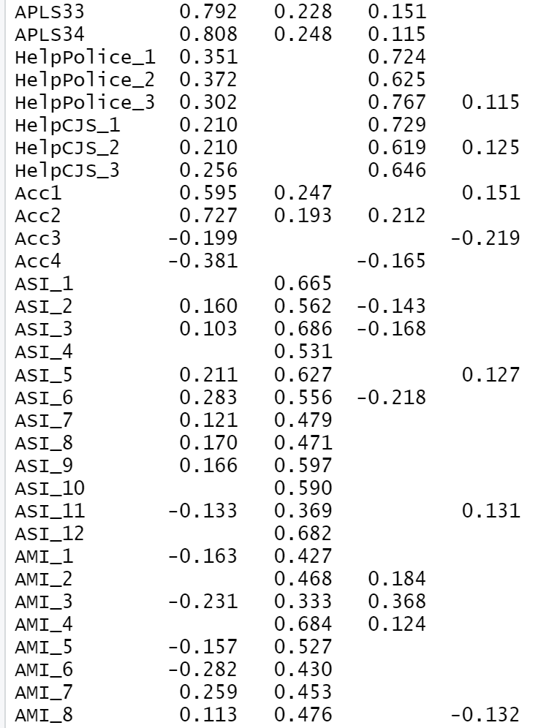
Factor Analysis Model 2
Attitudes Towards Police (APLS), Helping Police (HelpPolice), Helping Legal System (HelpCJS), Effectiveness of Police & Legal System [Accuracy] (Acc), Sexism Women (ASI), Sexism Men (AMI), World Views (GBJW), Effectiveness of Police & Legal System [Effectiveness] (Eff)
Appendices D,E,F
4 Factors

Slide 19
Summary of Factor Analysis Model 2 ( With 4 Factors)
Factors
F1 | F2 | F3 | F4
APLS | ASI | HelpPolice | Eff3 & Eff4
Acc1 & Acc2 | AMI | HelpCJS
Eff1 & Eff2
GBJW_1–7 (except for GBJW_4) | GBJW_1 GBJW_4 GBJW_5
APLS is correlated with Factor 1
Acc1 and Acc2 are correlated with Factor 1, but Acc3 and Acc4 do not appear to be correlated with any particular factor
HelpPolice and HelpCJS are correlated with Factor 3
ASI and AMI are correlated with Factor 2
Most of GBJW is contained within Factor 1, but GBJW_1 and GBJW_5 are similarly correlated with both factors 1 and 2. Also, GBJW_4 is correlated with Factor 2 and not Factor 1
Eff1 and Eff2 are correlated with Factor 1
Eff3 and Eff4 are correlated with Factor 4.

Slide 20
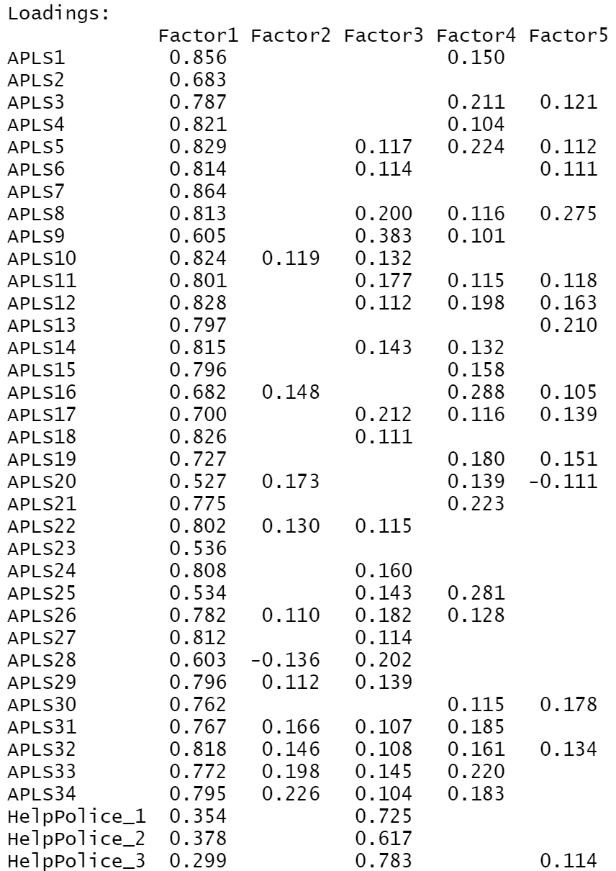
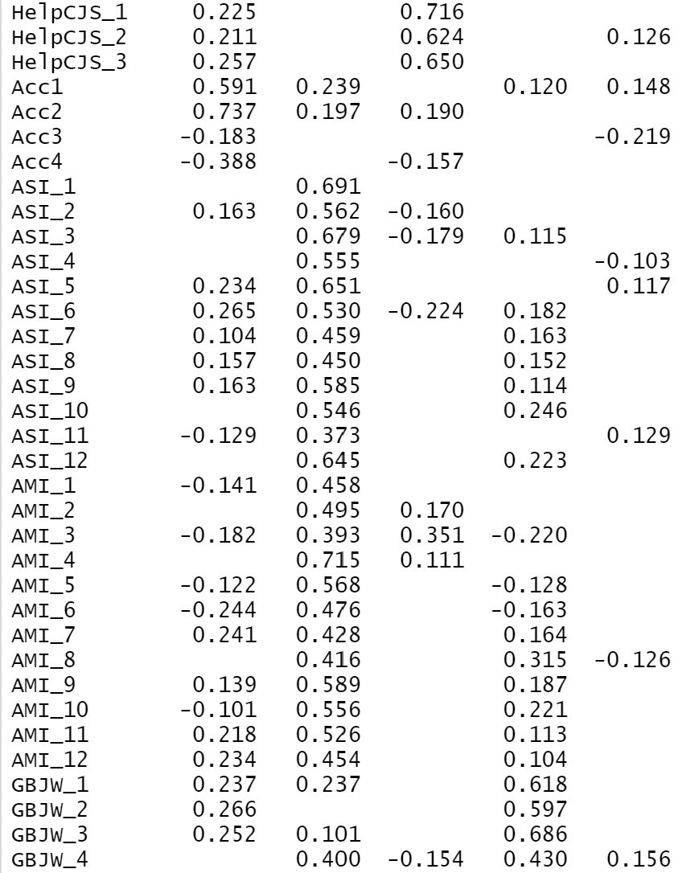
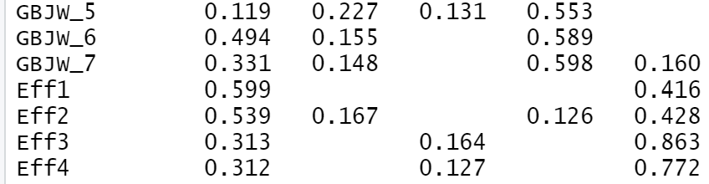
Factor Analysis Model 2
Attitudes Towards Police (APLS), Helping Police (HelpPolice), Helping Legal System (HelpCJS), Effectiveness of Police & Legal System [Accuracy] (Acc), Sexism Women (ASI), Sexism Men (AMI), World Views (GBJW), Effectiveness of Police & Legal System [Effectiveness] (Eff)
Appendices D,E,F
5 Factors

Slide 21
Summary of Factor Analysis Model 2 ( With 5 Factors)
Factors
The observations of APLS are correlated with Factor 1
The observations of HelpPolice and HelpCJS are correlated with Factor 3
The observations of ASI and AMI are correlated with Factor 2
Acc1 and Acc2 are correlated with Factor 1, but Acc3 and Acc4 are not correlated with any factors. Even when increasing factor amount to 6, 7, and 8, Acc3 and Acc4 continued to not be correlated with any factor.
GBJW is correlated with Factor 4
Eff1 and Eff2 are correlated with Factor 1, but Eff3 and Eff4 are correlated with Factor 5.
F1 | F2 | F3 | F4 | F5
APLS | ASI | HelpPolice | GBJW | Eff3 & Eff4
Acc1 & Acc2 | AMI | HelpCJS
Eff1 & Eff2

Slide 22
Comparing Both Models ( 4 Factors and 5 Factors )
4 Factors
5 Factors
F1 | F2 | F3 | F4
APLS | ASI | HelpPolice | Eff3 & Eff4
Acc1 & Acc2 | AMI | HelpCJS
Eff1 & Eff2
GBJW_1–7 (except for GBJW_4) | GBJW_1 GBJW_4 GBJW_5
F1 | F2 | F3 | F4 | F5
APLS | ASI | HelpPolice | GBJW | Eff3 & Eff4
Acc1 & Acc2 | AMI | HelpCJS
Eff1 & Eff2
Similarities between Factors 4 and 5
Differences
APLS with factor 1
Acc1 & Acc2 with factor 1
Eff1 & Eff2 with factor 1
ASI & AMI with factor 2
HelpPolice & HelpCJS with factor 3
Eff3 & Eff4 with their own factor
Acc3 & Acc4 belong to no factor
GBJW was originally split between factor 1 & 2, but with the 5 factor model, it becomes correlated with its own factor 4.
Eff3 & Eff4 with factor 5 instead of 4

Slide 23
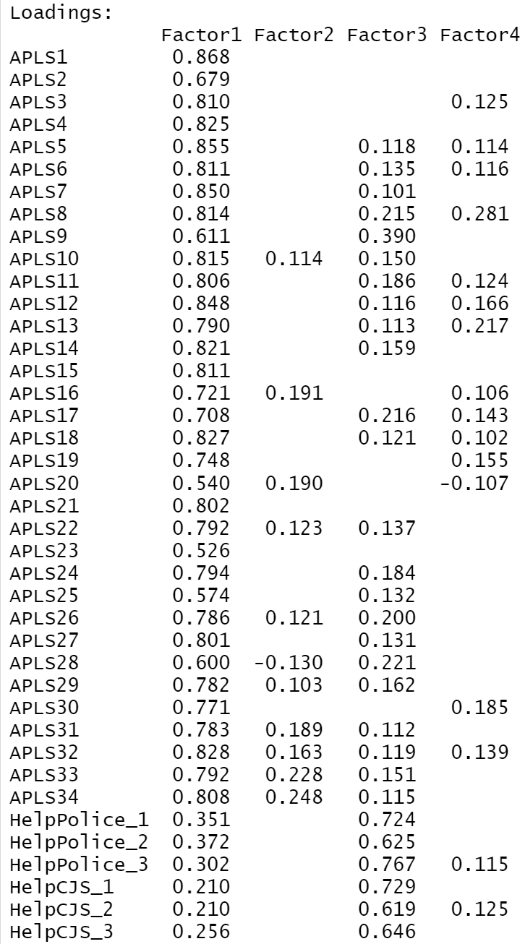
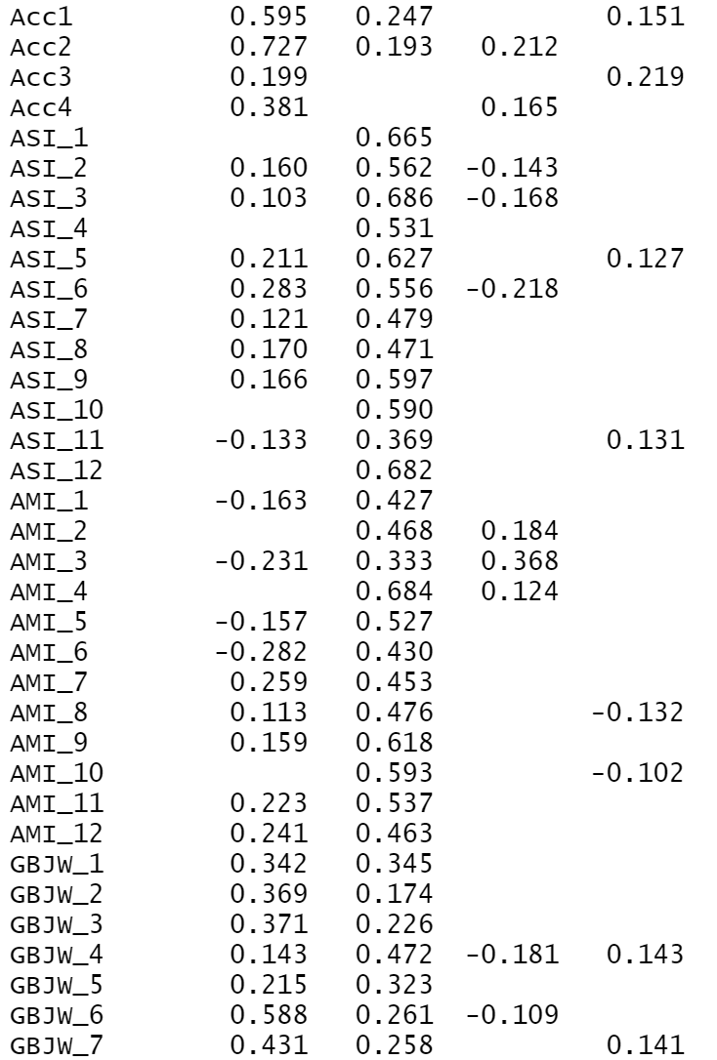
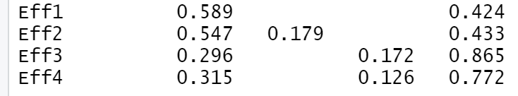
Factor Analysis Model 2
Attitudes Towards Police (APLS), Helping Police (HelpPolice), Helping Legal System (HelpCJS), Effectiveness of Police & Legal System [Accuracy] (Acc), Sexism Women (ASI), Sexism Men (AMI), World Views (GBJW), Effectiveness of Police & Legal System [Effectiveness] (Eff)
Appendices D,E,F
4 Factors
(With Reverse Scoring for Acc3 & Acc4)

Slide 24
(With Reverse Scoring for Acc3 & Acc4)
Summary of Factor Analysis Model 2 ( With 4 Factors)
All of APLS is correlated with factor 1
All of Acc is correlated with factor 1, but Acc3 is also correlated with factor 4
GBJW 1-3 and 6-7 are correlated with factor 1, but GBJW 4 & 5 are correlated with factor 2
Eff 1-2 is correlated with factor 1, but Eff 3-4 is correlated with factor 4
ASI and AMI are correlated with factor 2, but AMI_3 is also correlated with factor 3
HelpPolice and HelpCJS are correlated with factor 3
Factors
F1 | F2 | F3 | F4
APLS | ASI | HelpPolice | Acc3
Acc | AMI | HelpCJS | Eff3 & Eff4
GBJW 1-3, and 6-7 | GBJW_4 GBJW_5 | AMI_3
Eff 1-2

Slide 25
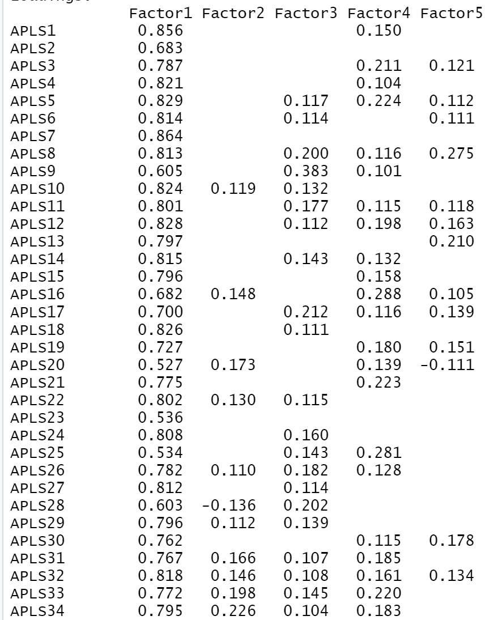
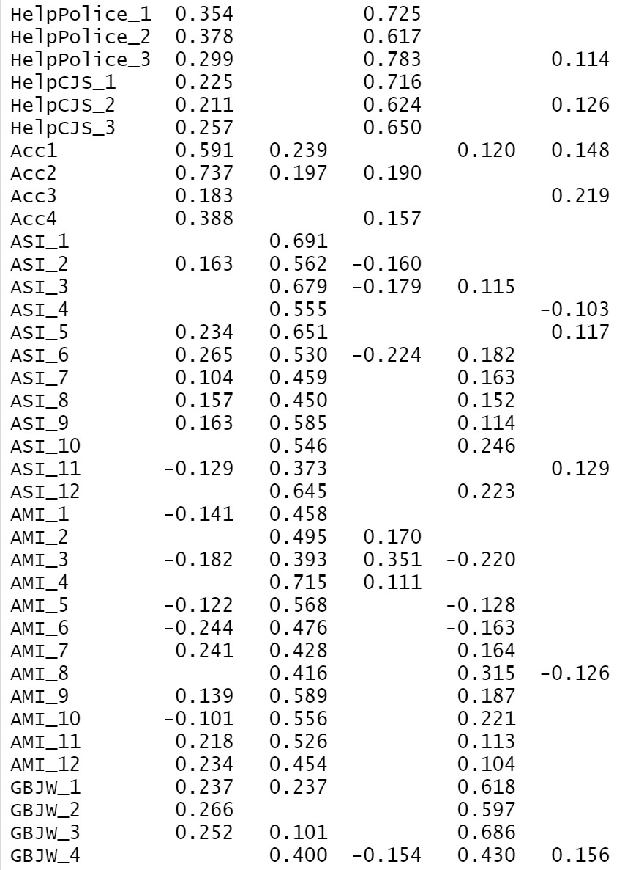
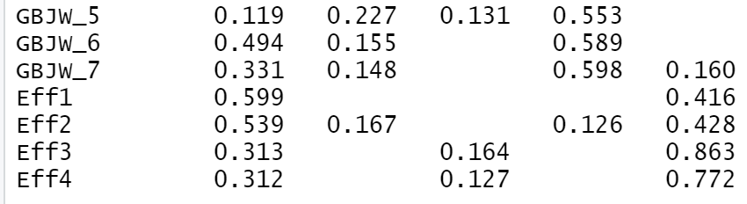
Factor Analysis Model 2
Attitudes Towards Police (APLS), Helping Police (HelpPolice), Helping Legal System (HelpCJS), Effectiveness of Police & Legal System [Accuracy] (Acc), Sexism Women (ASI), Sexism Men (AMI), World Views (GBJW), Effectiveness of Police & Legal System [Effectiveness] (Eff)
Appendices D,E,F
5 Factors
(With Reverse Scoring for Acc3 & Acc4)

Slide 26
(With Reverse Scoring for Acc3 & Acc4)
Summary of Factor Analysis Model 2 ( With 5 Factors)
Factors
All of APLS is correlated with factor 1
All of Acc is correlated with factor 1, but Acc3 is also correlated with factor 5
Eff1 & Eff2 is correlated with factor 1, while Eff3 & Eff4 is correlated with factor 5
ASI and AMI are correlated with factor 2, but AMI_3 is also correlated with factor 3
All of GBJW is correlated with factor 4, but GBJW_4 is also correlated with factor 2
HelpPolice and HelpCJS are correlated with factor 3
F1 | F2 | F3 | F4 | F5
APLS | ASI | HelpPolice | GBJW | Eff3 & Eff4
Acc | AMI | HelpCJS |  | Acc_3
Eff1 & Eff2 | GBJW_4 | AMI_3

Slide 27
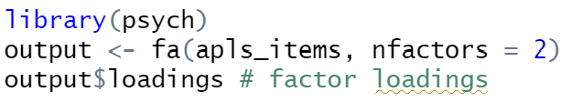
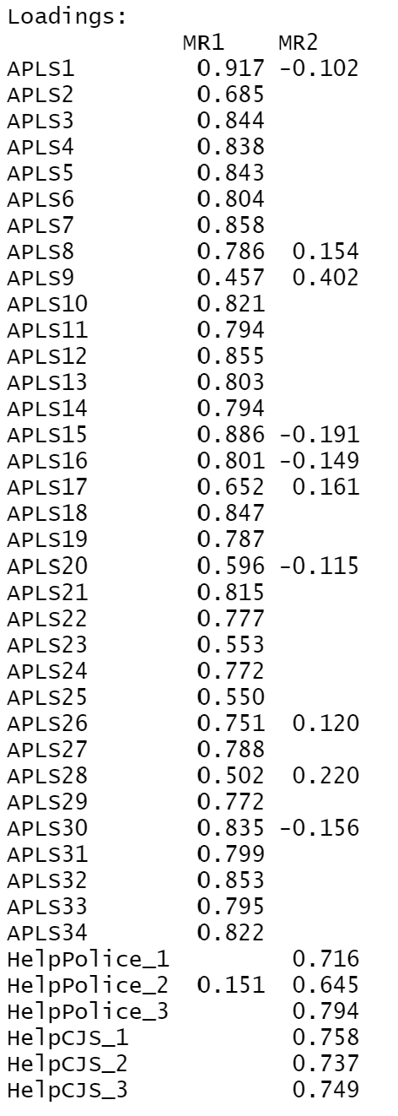
factanal()
fa()
Comparing the use of the two factor analysis functions, factanal() and fa(), to explore factor analysis model 1
Using factanal(), APLS appears to distinctly be a part of factor 1, with HelpPolice and HelpCJS part of factor 2.
Using fa(), we also get that APLS is part of factor 1 and HelpPolice and HelpCJS factor 2.

Slide 28
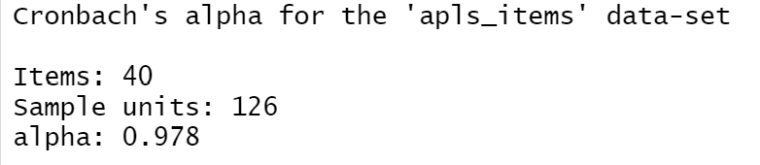
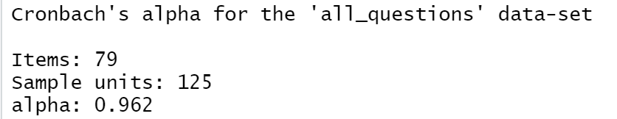
Cronbach’s Alpha Both Models ( 4 Factors and 5 Factors )
Factor Analysis Model 2
Factor Analysis Model 1
(Same for both 4 and 5 factors)
Alpha is > 0.7 for both models, indicating reliability
Despite factor analysis model 2 having a much larger number of items/questions than model 1, it produces a smaller value of alpha
It appears that model 1 (APLS, HelpPolice, HelpCJS) may be a slightly more reliable model than model 2, which accounts for all questions in appendices D,E, and F.

Slide 29
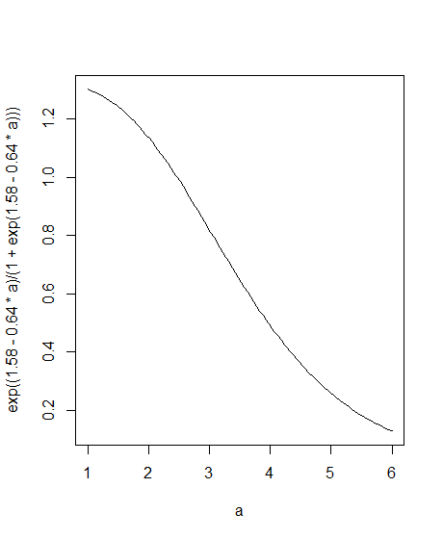
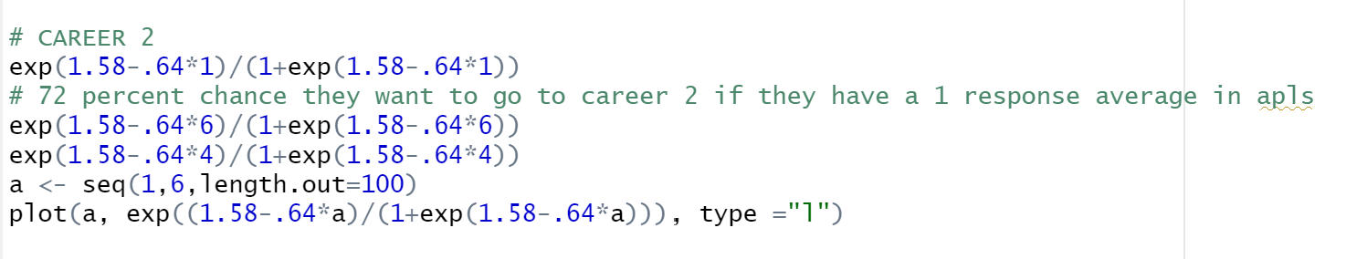
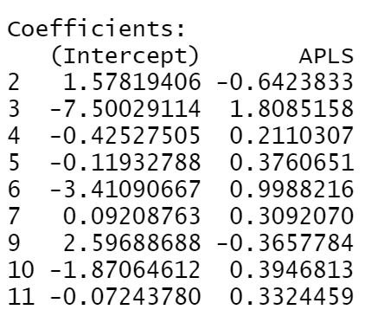
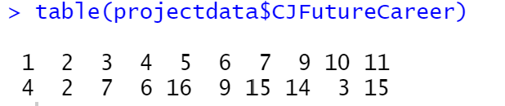
Does Police Attitude (APLS) Correlate to Type of Criminal Justice Career Chosen (CJFutureCareer)?
Multinomial Log-Linear Model Using multinom() function from library(nnet)
Example: If a student has an average response of 1 in APLS, there is a 72% chance they want to go into career 2
APLS average student response

Slide 30
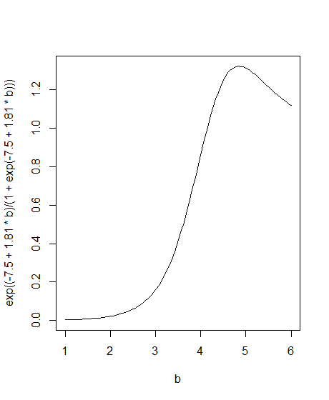
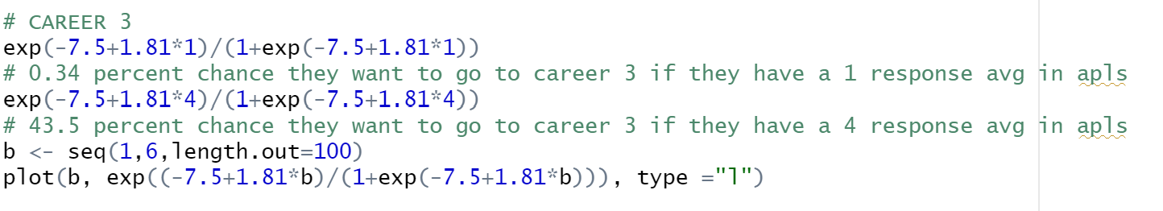
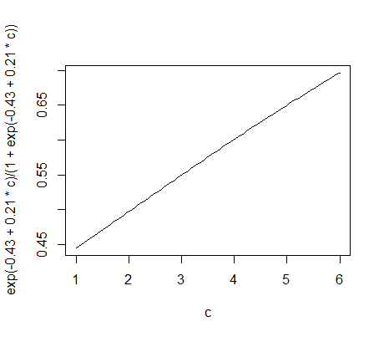
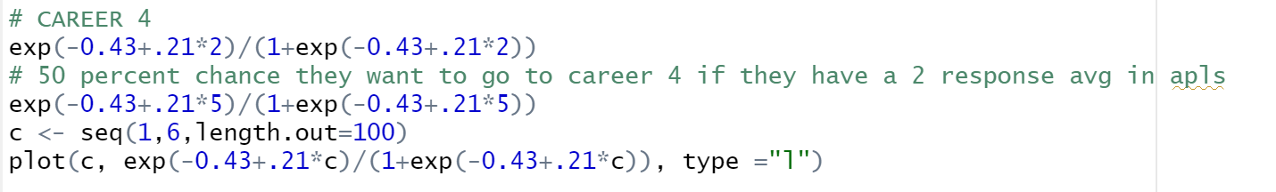
CJ Careers 3 and 4

Slide 31
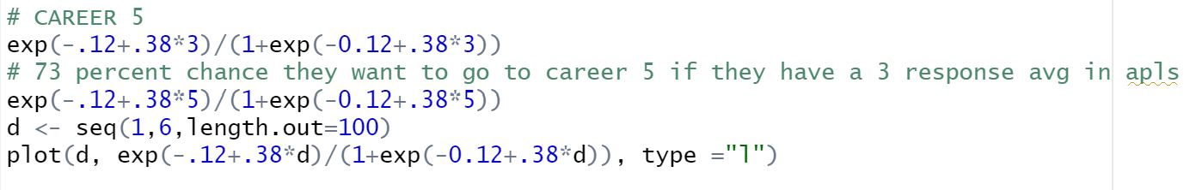
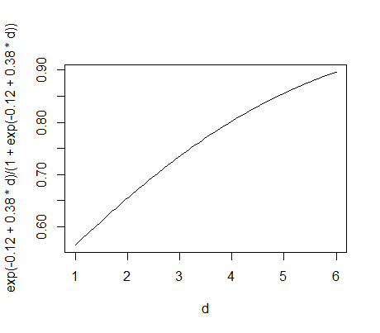
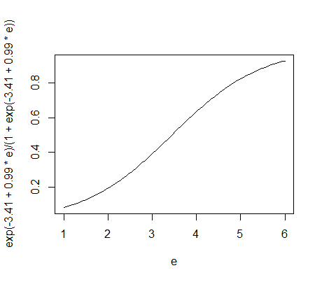
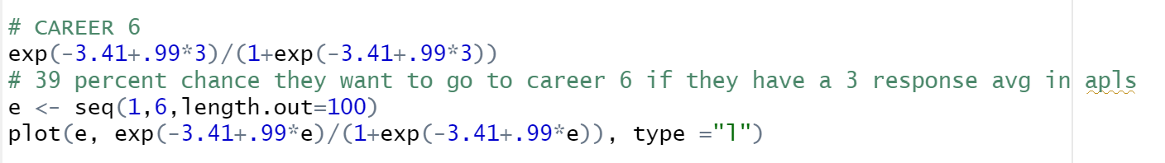
CJ Careers 5 and 6

Slide 32
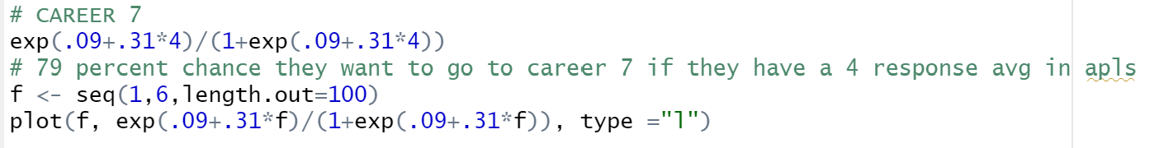
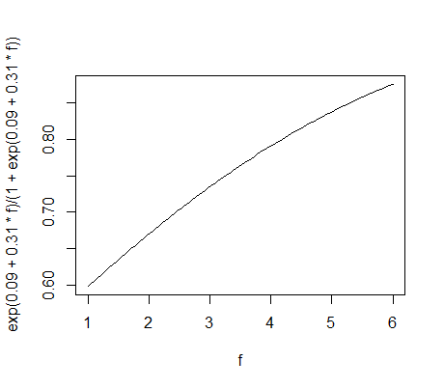
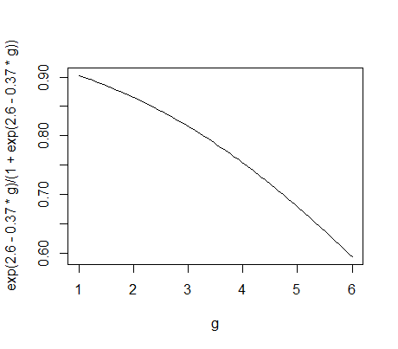
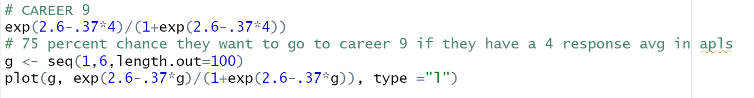
CJ Careers 7 and 9

Slide 33
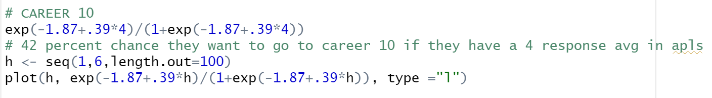
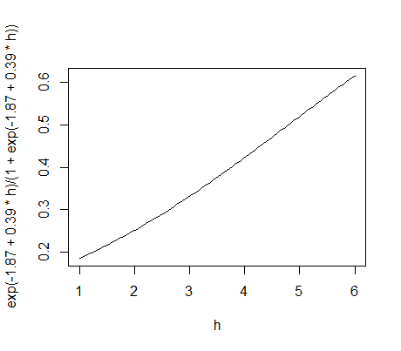
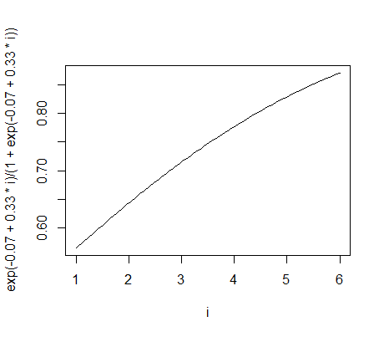

CJ Careers 10 and 11

